Slide 1
Central limit theorem

Slide 2
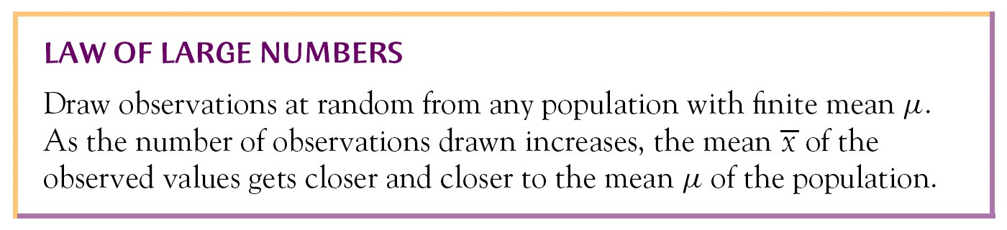
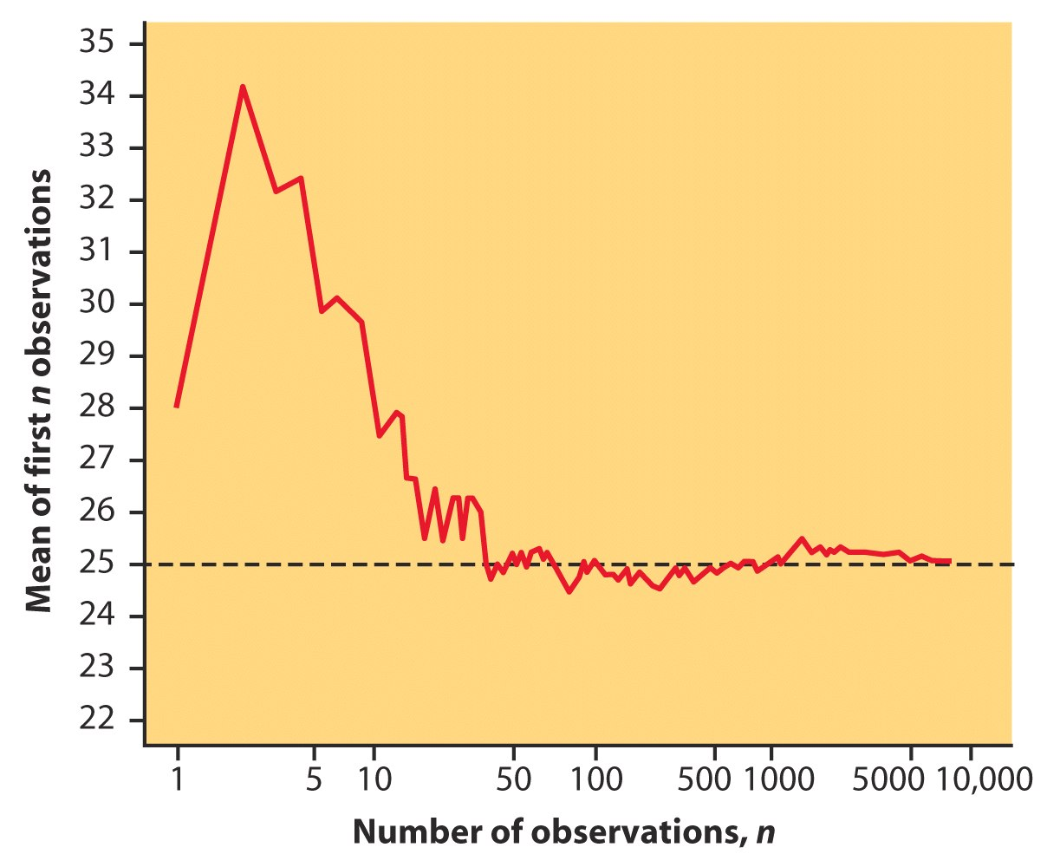

Slide 3
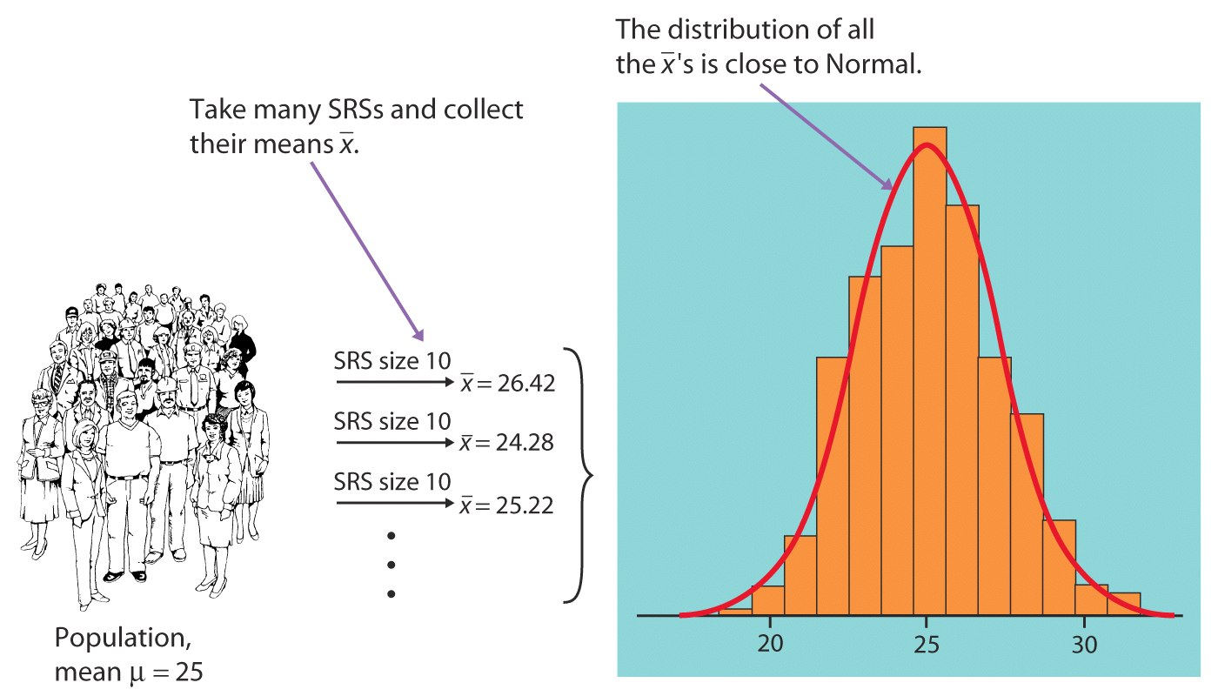
The mean of the distribution of sample means (SRS – simple random sample)

Slide 4
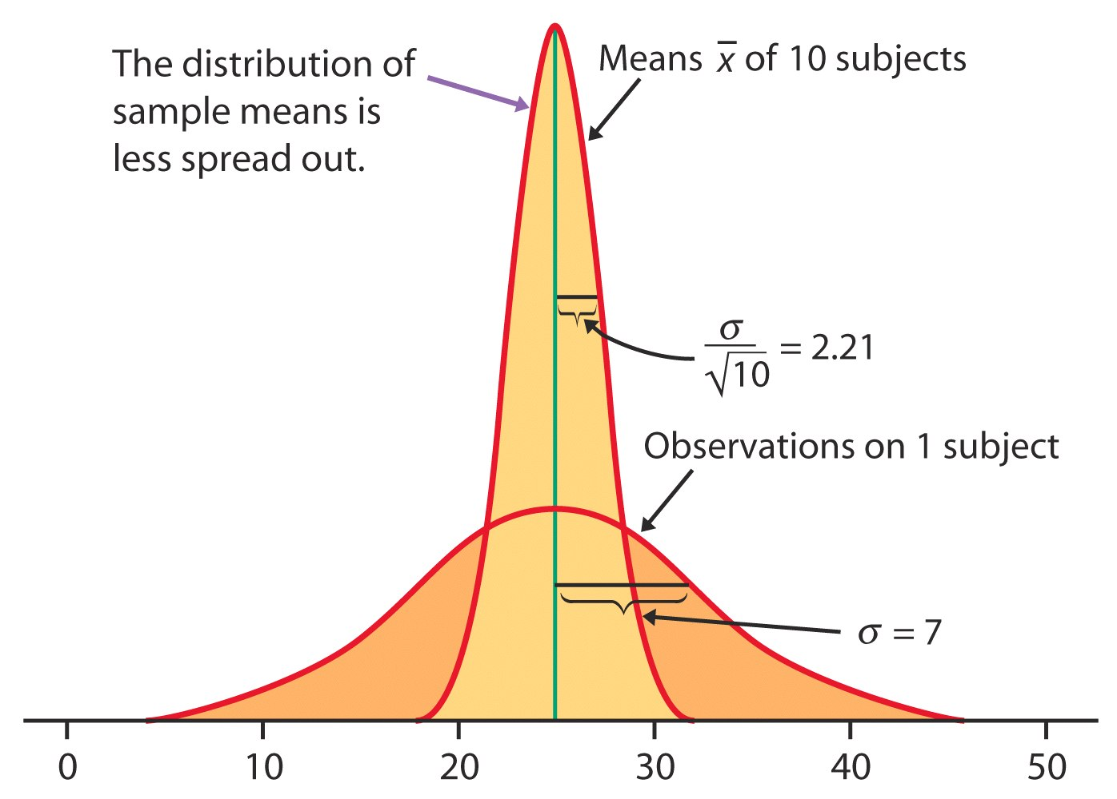
The standard deviation of the distribution of sample means

Slide 5
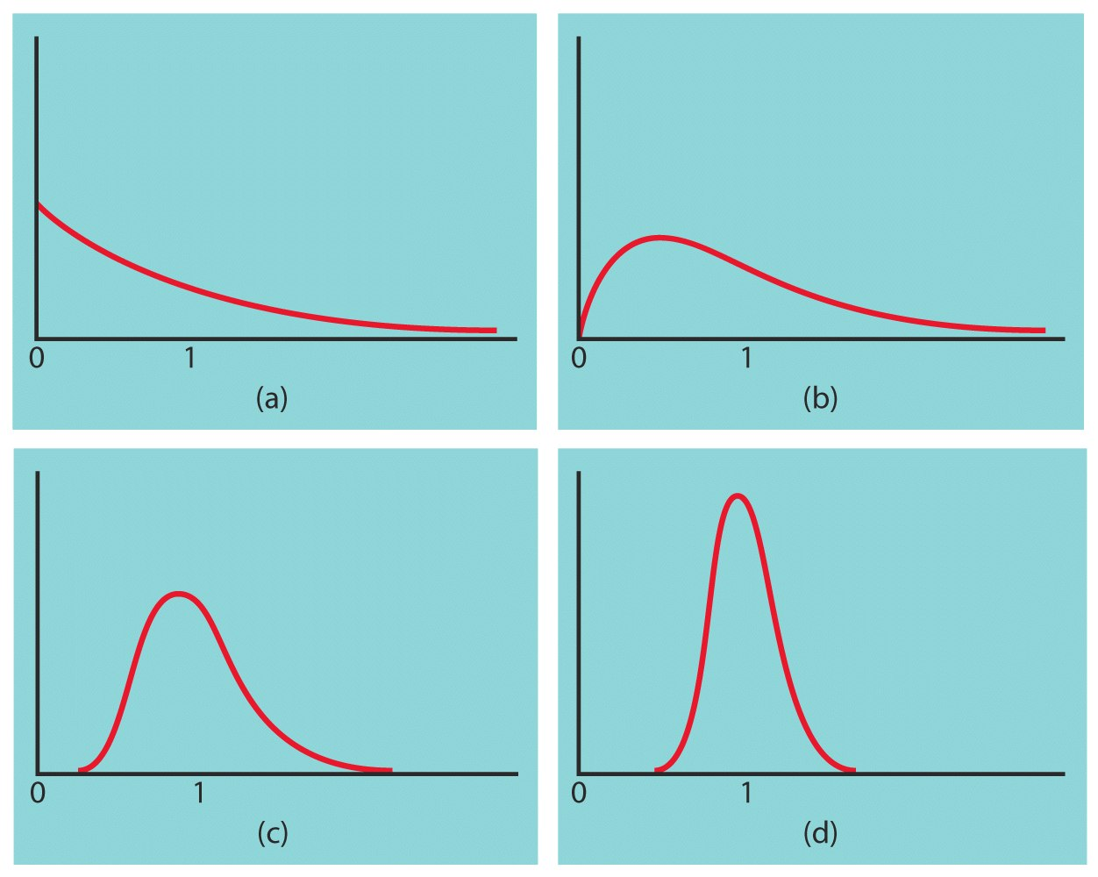
These figures illustrate the sampling distributions of sample means based on different sample sizes:
(a) n = 1
(b) n = 10
(c) n = 20
(d) n = 70

Slide 6
Central Limit Theorem
specifies a theoretical distribution
formulated by the selection of all possible random samples of a fixed size n
a sample mean is calculated for each sample and the distribution of sample means is considered

Slide 7
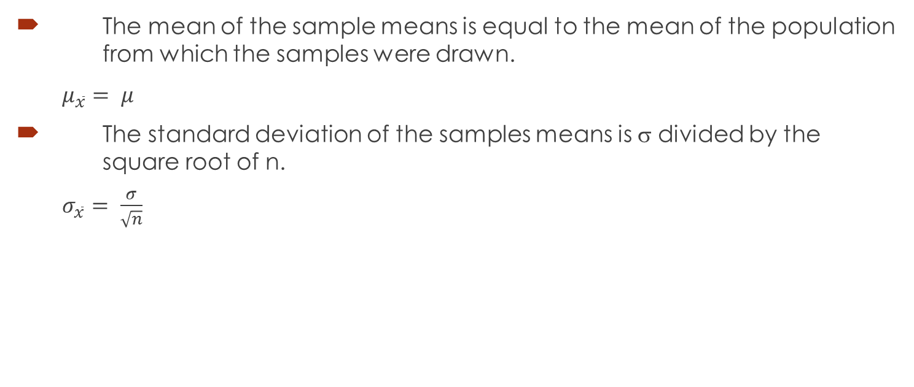
The mean and standard deviation of the samples means
The mean of the sample means is equal to the mean of the population from which the samples were drawn.
$μ_{\overline{x}}= μ$
The standard deviation of the samples means is σ divided by the square root of n.
$σ_{\overline{x}}= \frac{σ}{\sqrt{n}}$

Slide 8
Implications of the CLT
If the sampled population is normal, then the sampling distribution of the means will also be normal, no matter the sample size.
When the sampled population is approximately symmetric, the distribution becomes approximately normal for relatively small values of n (as small as 15).
When the sampled population is skewed, the sample size must be larger (i.e., 30 or more) before the sampling distribution of means becomes approximately normal.

Slide 9
Let’s visualize CLT
https://vimeo.com/75089338

Slide 10

Question
Central Limit Theorem – Why?

Slide 11

Example
A certain brand of tires has a mean life of 25,000 miles with a standard deviation of 1600 miles.
What is the probability that the mean life of 64 tires is less than 24,600 miles?

Slide 12
Solution
The sampling distribution of the means has a mean of 25,000 miles (the population mean)
μ = 25000 mi.
and a standard deviation (i.e.. standard error) of:
1600/8 = 200

Slide 13
Convert 24,600 mi. to a z-score and use the z – table to determine the required probability.
z = (24600-25000)/200 = -2
P(z< -2) = 0.0228
or 2.28% of the sample means will be less than 24,600 mi.

Slide 14
Practice
1. A certain group of EI recipients receives benefits averaging $340 per week with a standard deviation of $60. Consider the population to be normally distributed. If a random sample of 25 people is taken, what is the probability their mean benefit will be greater than $ 370 per week?

Slide 16
2. A population of 31 year-old males has a mean salary of $59,321 with a standard deviation of $4,120. If a sample of 100 men is taken, what is the probability their mean salaries will be less than $58,000?

Slide 18
There are 220 dogs at a dog show who weigh an average of 11 pounds, with a standard deviation of 7 pounds. Consider the weights of dogs to be normally distributed.
a) If a dog is chosen at random, what is the probability it has an average weight of greater than 7 pounds and less than 15 pounds?
b) If 50 dogs are chosen, what is the probability that their mean weight is less than 8 pounds?

